Slide 1
Coach Notes
This lesson is a bit lengthy and will be difficult if the students are not properly prepared.
Stress to the students before class that they should begin building part of the circuit and to take their time.
This circuit will be difficult to build in a hurry and is prone to error so it would be best for them to build most of it before class.
There is a written description of the circuit which may be easier for the students to use.
This lesson only has the stopwatch and can be completed as an extension or used to challenge students.

Slide 2
Machine Learning with Raspberry Pi
4-Digit 7-Segment Display
AI Code Academy

Slide 3
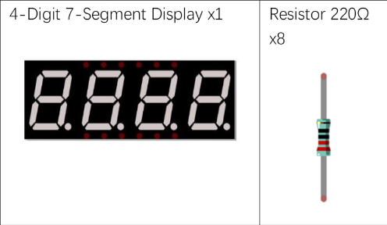
Materials Needed
For this lesson, we’ll need the following materials:
Raspberry Pi with SSH and VNC connection
Breadboard
GPIO extension board and wire
8 x 220 Ohm resistor
Button
Switch
4 Digit 7 Segment
Jumper wires

Slide 4
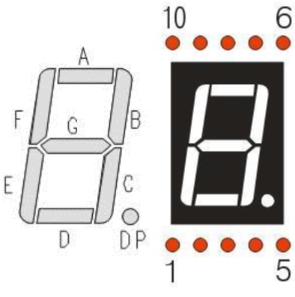
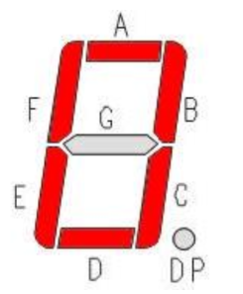

7-Segment Review
In a 7-Segment, 7 LEDs are arranged in a shape that can be selectively lit to create any number. With a decimal point, there are 8 LEDs in total.
Each LED has a common Anode and individual Cathodes.

Slide 5
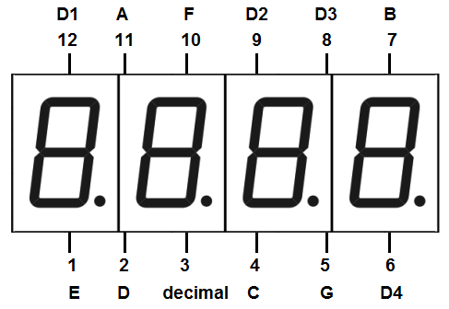
4-Digit 7-Segment
To the right is the pinout for the 4-digit 7 segment and we can see that there are the pins A-G for the individual segments and pins for D1-D4.
The D1-D4 pins are to control which segment is turned on and we can control the display by turning on a display and then outputting the proper value for A-G.
If we turn on only one display at a time, how can we view each at once?

Slide 6
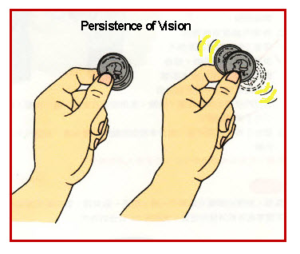
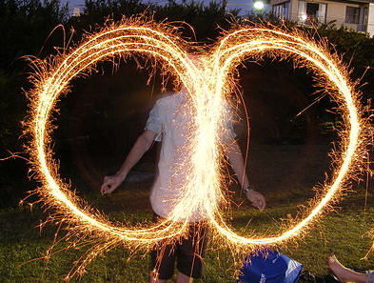
Persistence of Vision
Have you ever moved your hand quickly and created a smear effect where you saw your hand at different points.
This illusion is persistence of vision and there is period after we see light where it remains in our vision before it disappears.
We will use this property to quickly turn on and off the displays so that they will register in our vision and each display will appear to be on at the same time.
If we change the displays at too slow of a speed, the illusion will fail, and we will see flickering.

Slide 7
4-Digit 7-Segment
We will use a frequency of at least 200Hz when we turn all the displays on and off to create the illusion that all of them are on. We must turn on each segment and output the digit all within 5ms.
We can slow down our code so that we can view each segment turn on.
The display is common anode, and we will use the same approach to setting the values of A-G as we did for the one digit 7-segment.

Slide 8
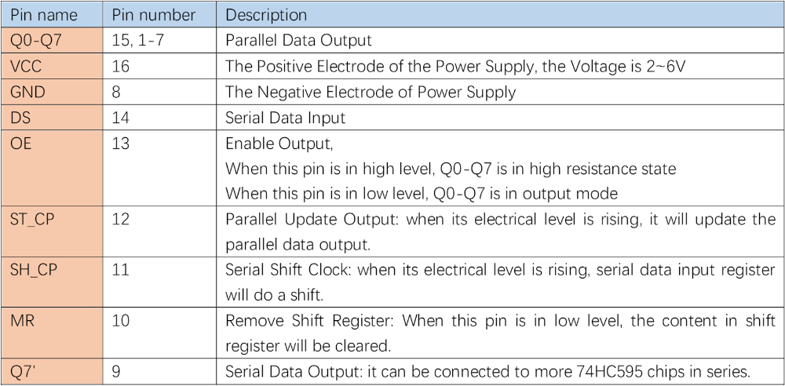
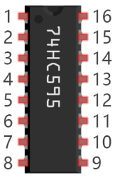
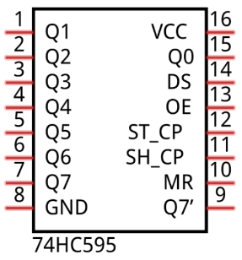
Integrated Circuit (IC) Review
The 74HC595 is an integrated circuit used to store data sent from a serial input and output it as parallel data. The register can perform shift operations and store 1 byte of data. Using this chip, we can output data from the Pi and only need to use 3 pins rather than 8.

Slide 9
Project
For our project, we are going to create a circuit that will act as a stopwatch and will be triggered by a button.
For the stopwatch, the first two digits will be the minute and the other two will be the seconds. A button will be used to start and stop the stopwatch.
Please open the template file which contains code from the level 2’s class.
We will first test the display and then program it to act as a stopwatch.

Slide 10
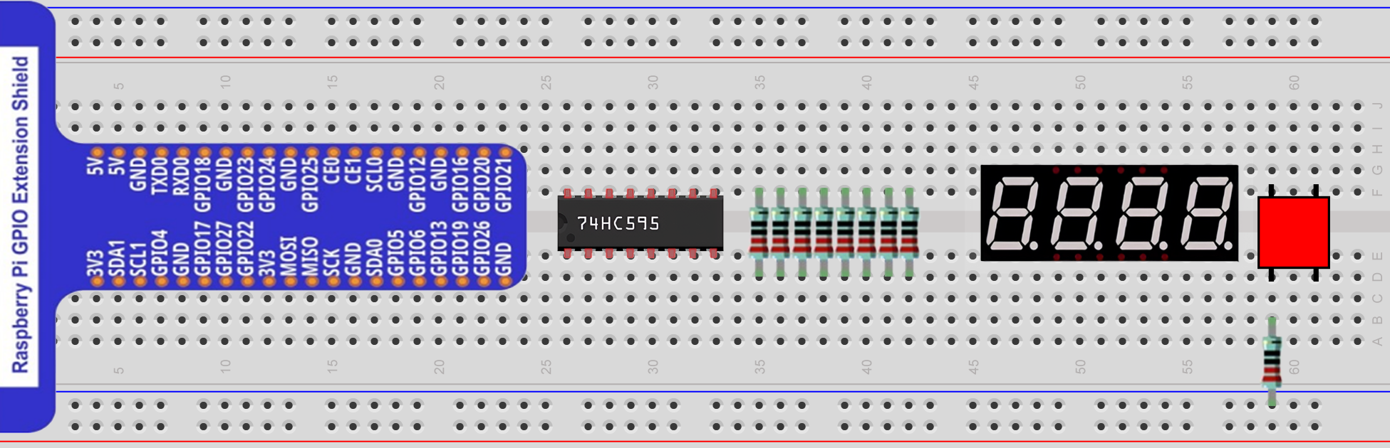
Circuit for this Project
This project’s wiring is very difficult so we will first look at the circuit without the connection wires.

Slide 11
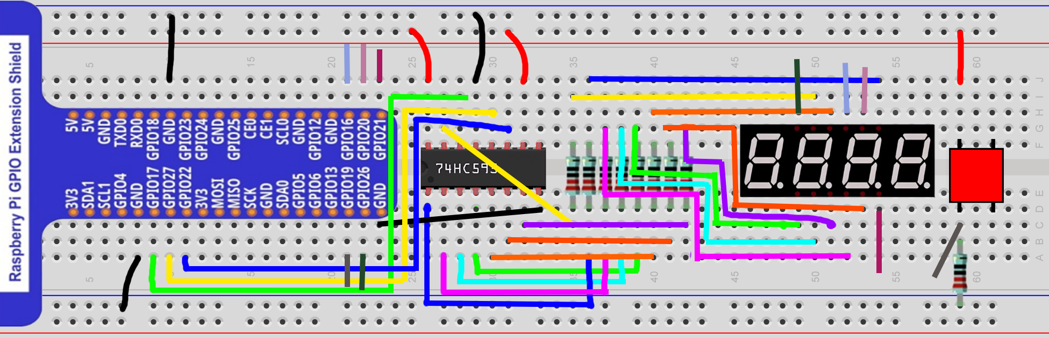
Circuit for this Project
We will now add the wires, please note that the wires leaving GPIO 19, 26, 16, 20, and 21 do not show the full connection only their endpoints with a small portion of the wire. This is done to simplify the diagram and make the connections more visible. Please ask any questions if you are unsure where a wire goes.

Slide 12
Written Description
GPIO 17 - Register 14
GPIO 27 - Register 12
GPIO 22 - Register 11
GPIO 19 - Button Input
GPIO 26 - D1
GPIO 16 - D2
GPIO 20 - D3
GPIO 26 - D4
Register 16 - 3.3V
Register 14 - GPIO 17
Register 13 - GND
Register 10 - 3.3V
Register 9 - Unconnected
Register 8 - GND
Q0 (Reg 15) - A Resistor - A
Q1 (Reg 1) - B Resistor - B
Q2 (Reg 2) - C Resistor - C
Q3 (Reg 3) - D Resistor - D
Q4 (Reg 4) - E Resistor - E
Q5 (Reg 5) - F Resistor - F
Q6 (Reg 6) - G Resistor - G
Q7 (Reg 7) - DP Resistor - DP

Slide 13
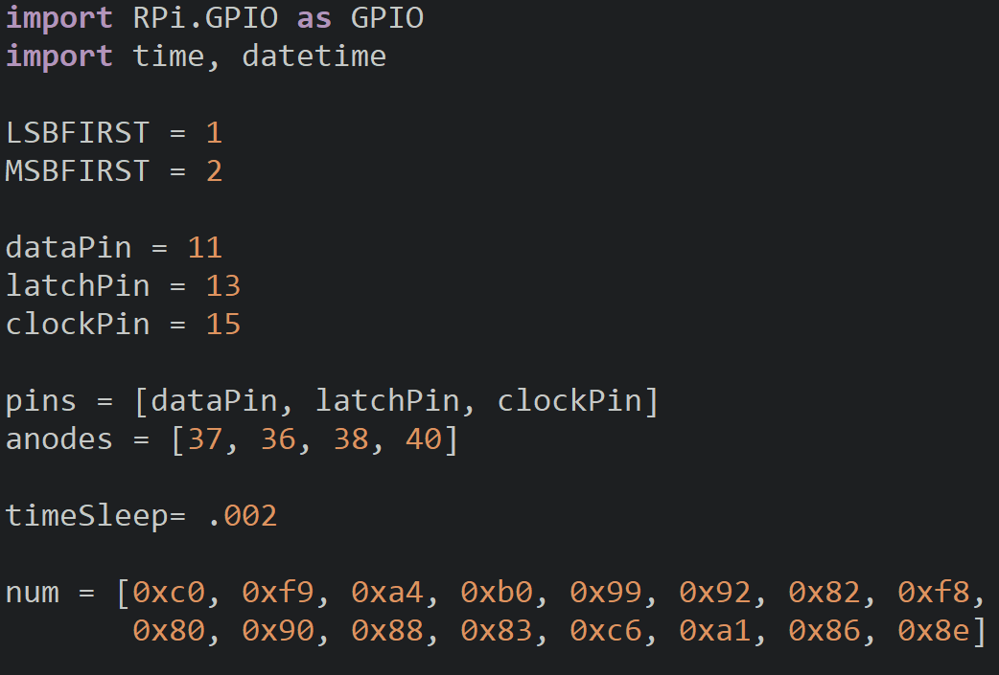
Setup
Create a list containg the pin numbers for the anodes of the display and oragnzie them as [D1, D2, D3, D4]
We have a timeSleep variable which controls the time we display the digits and then turn them off.
.002 (2ms) will be perfect as we will use two delays so our total delay will be roughly 4ms which is under the 5ms limit.

Slide 14
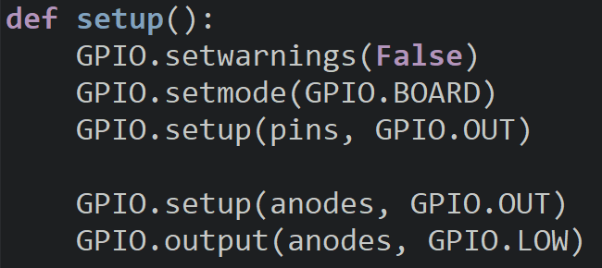
Setup
We will setup the shift register pins as outputs.
The anodes will be setup as outputs and then we will turn them all off.

Slide 15
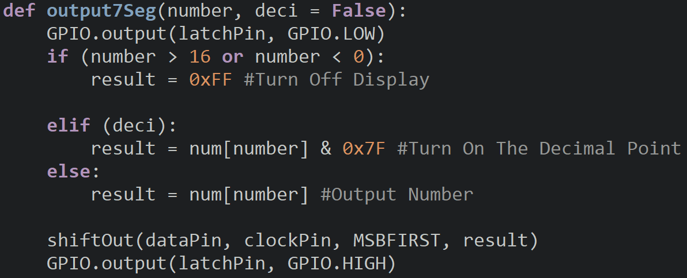
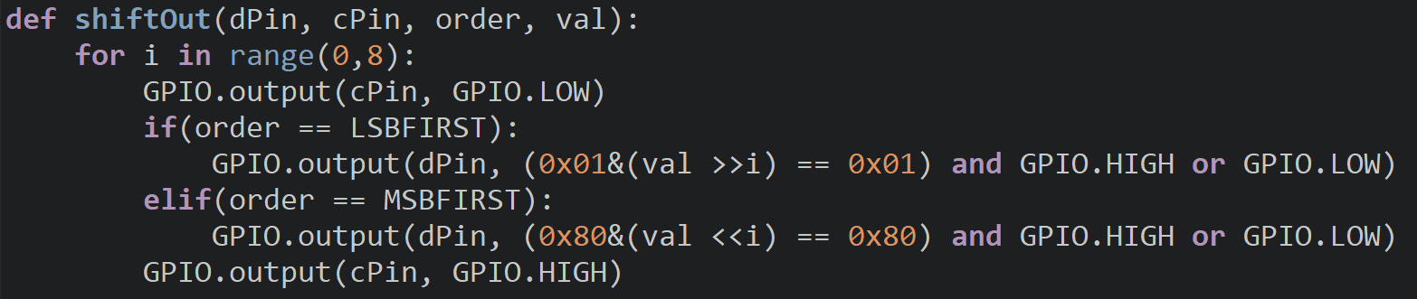
7-Segment Functions
These functions were developed in the L2 7-Seg project and will be used again to handle the segments of each display.

Slide 16
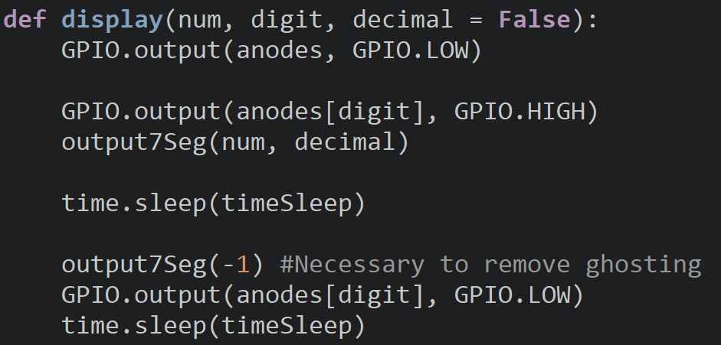
Display Function
The display function will take the number we want to output, the digit we want to output to and if we want the decimal point.
We will initially turn off all the displays and then turn on the display we want to affect by accessing the pin number from the anodes list.
We will then call the output7Seg function and pass to it the num and decimal. We will then use a delay so the output appears on the display.

Slide 17
Display Function
We will then output -1 to the display which will turn clear all the segments of the display and turn off the display then we sleep again.
We perform this to prevent ghosting, we will discuss this more in depth in our next lesson.
If you skip this step, a faint image of the next digit’s number will be behind yours.

Slide 18
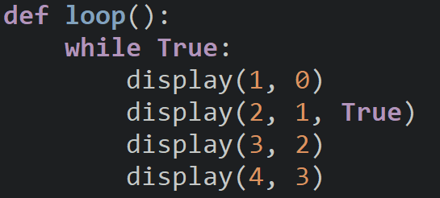
Loop
Inside of our loop we will first test out our new functions by displaying 1234.
We will then call the display function four times and pass to it each digit to the 7-Segment.
For the 2nd digit, we turn on the decimal.

Slide 19
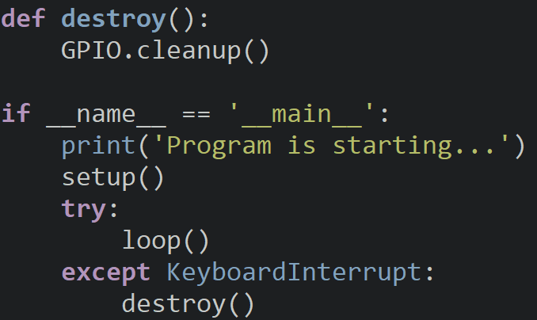
Destroy & Entrance
The classic destroy and program entrance.

Slide 20
Try It Out
Did the sequence display on the 7-Segment?

Slide 21
Project
We will now modify our program so that it will call a function called stopWatch and use a button to change whether or not we will count or not.

Slide 22

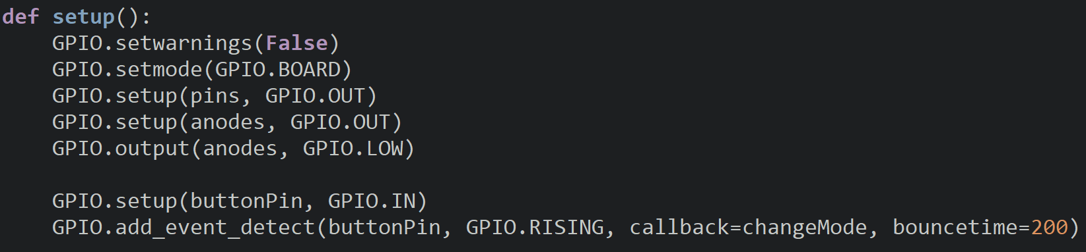
Setup
We will create a variable for the buttonPin and a variable to keep track of the current mode of the stopwatch and initially set it to True.
Inside the setup function we will make the buttonPin an input and create an interrupt for it that triggers the changeMode function.

Slide 23
Extracting the Ten’s & One’s Digits
For us to display the time to the 7-Segment, we must isolate each of the digits from the hour and minute to save into separate variables.
If we have a number like 12,it has the ten’s place and one’s place and we need to isolate these so we can display the 1 on one display and the two on the other.
If we want to get the ten’s place, we will divide the number by 10 using integer division so it saves the whole number only. If we want the one’s place, we will use module 10 on the number.
Ten’s = 12//10 = 1
One’s = 12 %10 = 2

Slide 24
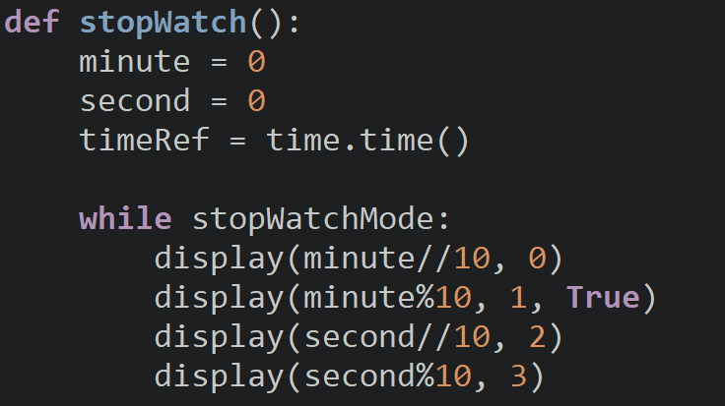
stopWatch()
Inside the function we will create a variable for the minute, second, and time reference.
We will use the time reference to keep track of the time so that we can always output to the display since if we used time.sleep, we would only see the display for a moment.
While stopWatchMode is true (run stopwatch), we will display the minute and second onto the displays in a similar manner to the clock.

Slide 25
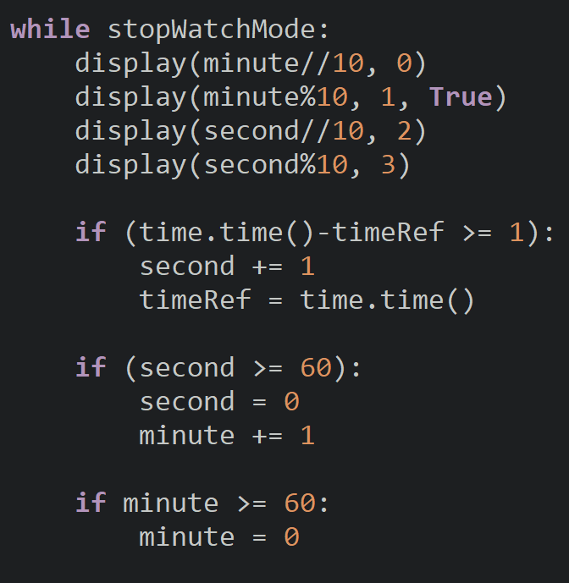
stopWatch()
We will increment the value of the second variable if the difference between the current time and the time reference is greater than or equal to 1 and then reset the reference.
We then will check if the time is valid and if the second is greater than or equal to 60, we will reset the seconds and increment the minute.
If the minute is greater than or equal to 60, we will then set the minute equal to 0.
If we had more displays, we would increment the hour.

Slide 26
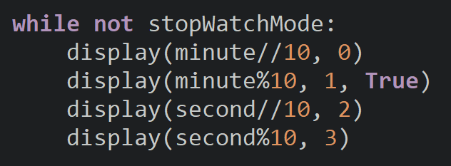
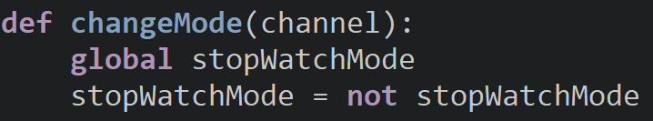
stopWatch() & changeMode()
To end the function, we have one more loop which will repeat until the mode is inverted once more and the final values of the stopwatch are displayed on the 7-Segments.
The changeMode function will invert the value of stopWatchMode.

Slide 27
Discussion
Did the stopwatch perform as expected?
How could we create an alarm that counts down?
What are some other projects that we can use the 4-digit 7-Segment for?
If we were given an 8-digit 7-Segment, would our code work for it? (assuming we added the pins for it)

Slide 28
Power off
As usual, shut down your pi properly before disconnecting power.

